Slide 1
Introduction to Security & Cryptography
Blockchain Technology

Slide 2
Outline
Security
Network Security
Aspects of Security
Threat and Attack
Active vs. Passive Attack
Security Services
Encryption

Slide 3


Slide 4
Security
Confidentiality:
Assurance that information is shared only among authorised people or organisations
Integrity:
Assurance that the information is authentic and complete; ensuring that information can be relied upon to be sufficiently accurate for its purpose
Availability:
Assurance that the systems responsible for delivering, storing and processing information are accessible when needed, by those who need them

Slide 5
Network Security
Network security is the security measures that are needed to protect data during the transmission.

Slide 6
Aspects of Security
Security attack: Any action that compromises the security of information owned by an organization.
Security mechanism: A mechanism that is designed to detect, prevent, or recover from a security attack.
Security service: A service that enhances the security of the data processing systems and the information transfers of an organization.
Designed to counter security attacks

Slide 7
Threat & Attack
Threat
A person, thing, event, or idea which poses some danger to an asset in terms of that asset's confidentiality, integrity, availability, or legitimate use.
Threats can be Passive: Monitoring but no alterations to the information and Active: Deliberate alteration of information
Attack
A realization of a threat; Any action that attempts to compromise the security of the information owned by an organization/person
Categories of Attacks:
Interruption
Interception
Modification
Fabrication

Slide 8
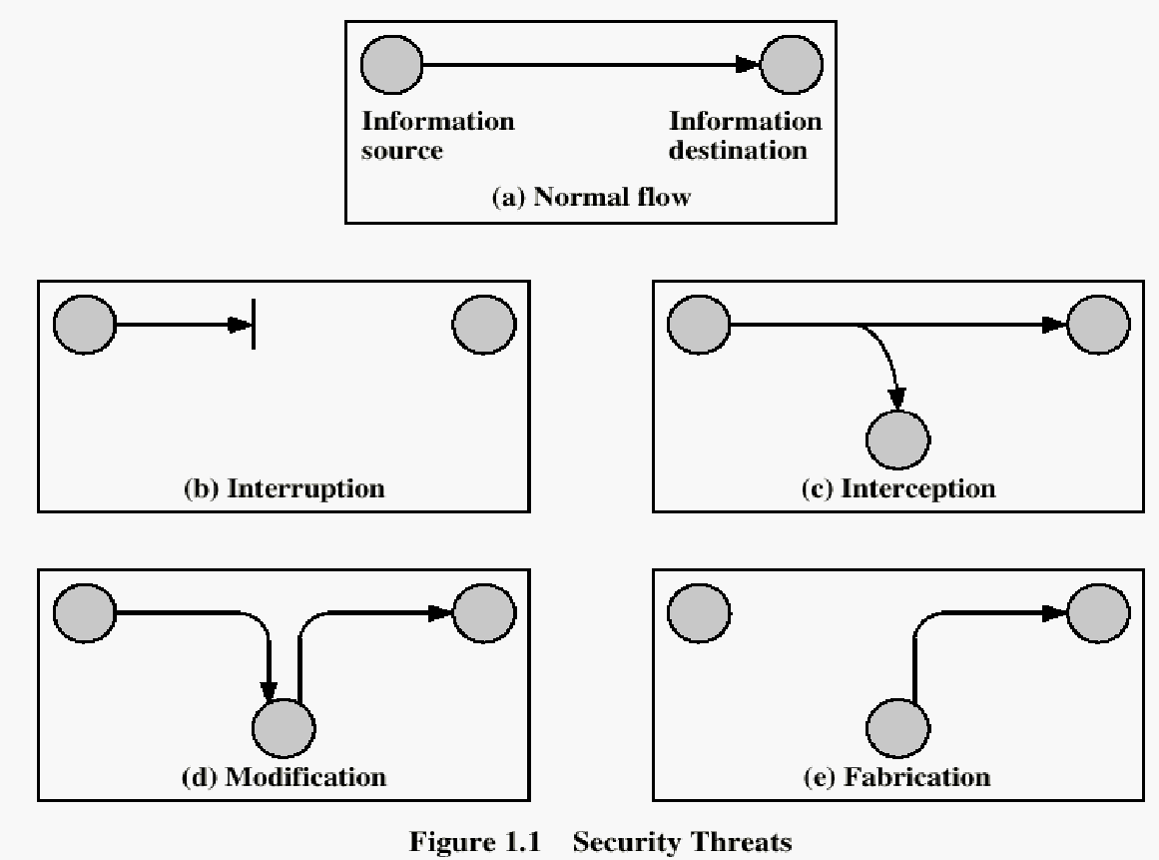

Slide 9
Interruption
Destroy hardware (cutting fiber) or software
Corrupt packets in transit
Denial of service (DoS):
Crashing the server
Overwhelm the server (use up its resource)
S
R

Slide 10
Interception
Unauthorized access to information
Packet sniffers and wire-tappers
Illegal copying of files and programs
S
R
Eavesdropper

Slide 11
Modification
Stop the flow of the message
Delay and optionally modify the message
Release the message again
S
R
Perpetrator

Slide 12
Fabrication
Unauthorized assumption of other’s identity
Generate and distribute objects under this identity
S
R
Masquerader: from S

Slide 13
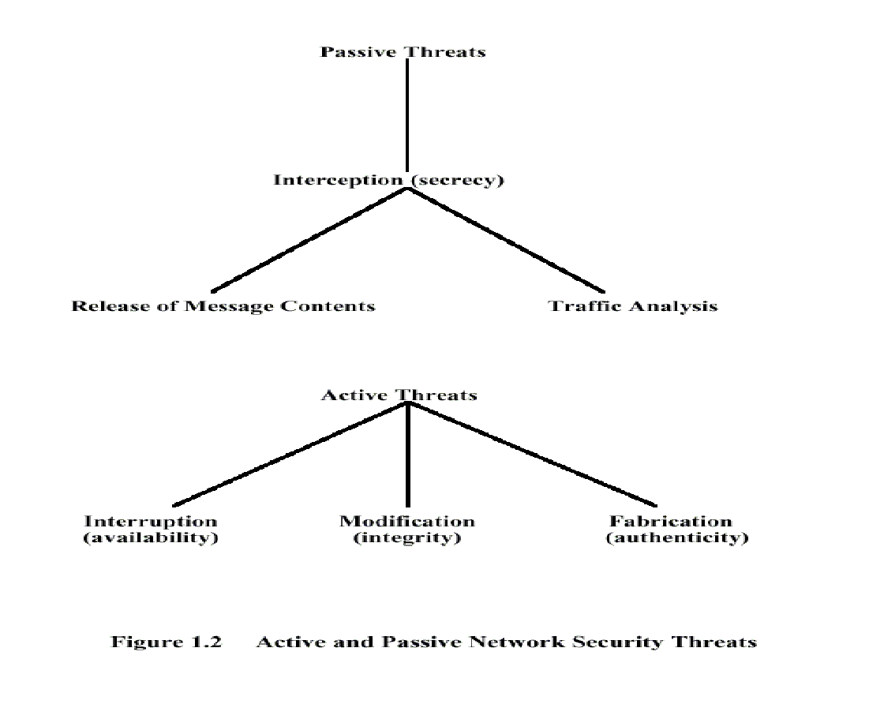

Slide 14
Passive Attacks
Passive attacks eavesdrop, or monitor, transmission
Goal: To obtain transmitted information.
2 Types of passive attacks:
Release of Content
Traffic Analysis

Slide 15
Passive Attack Types
Release of contents: A telephone conversation, an electronic mail message, or confidential information.
Traffic analysis: Using the location and identities of hosts and the frequency and length of messages to determine the type of communication taking place.
Passive attacks are difficult to detect since they do not involve any alteration of data.

Slide 16
Active Attacks
An active attack involves the modification of the data stream or the creation of a false stream
4 Types of active attacks:
Masquerade
Replay
Modification
Denial of Service

Slide 17
Active Attacks Types
Masquerade takes place when one entity pretends to be a different entity
example: Identity Theft
Replay involves the passive capture of a data unit and its subsequent retransmission to produce an unauthorized effect
Modification occurs when an unauthorized party gains access to and tampers with an asset
This is an attack on integrity
Denial of service prevents or slow down the normal use or management of communications facilities.

Slide 18
Security Services
Confidentiality is the protection of transmitted data from passive attacks.
Authentication is concerned with assuring that a communication is authentic.
Integrity ensures that messages are received as sent.
A connection-oriented integrity service should assure that there are no duplicates, insertions, deletions, modifications, reordering, or replays.
A connectionless integrity service deals only with an individual message.
Non-repudiation prevents either the sender or receiver from denying a transmitted message.
Access Control is the ability to limit and control the access to host systems and applications via communications links.
Availability is the ability to prevent the loss or a reduction in availability of elements of a distributed system.

Slide 19
Encryption
Information has to be concealed from an unauthorised person (attacker), so that in the event that it is passively accessed (e.g., copied or intercepted) by an attacker, it should not be useful to them
The concealment of information is achieved through the use of algorithms and formulas which change the text in a way that any intruder is refrained from understanding the actual message.
Two subjects that deal with the concealment of information from unauthorised people:
Steganography
Cryptography

Slide 20
Encryption Types: Steganography
Steganography ("covered writing") is the science of hiding information "in plain sight"
It is the study of hiding critical information within some other less important information
Examples: Knitted patterns containing secret messages, invisible ink, files within files, picture within video, etc.
Drawback: If the less important information is compromised, the attacker is not only able to identify, but extract and modify/destroy the critical information

Slide 21
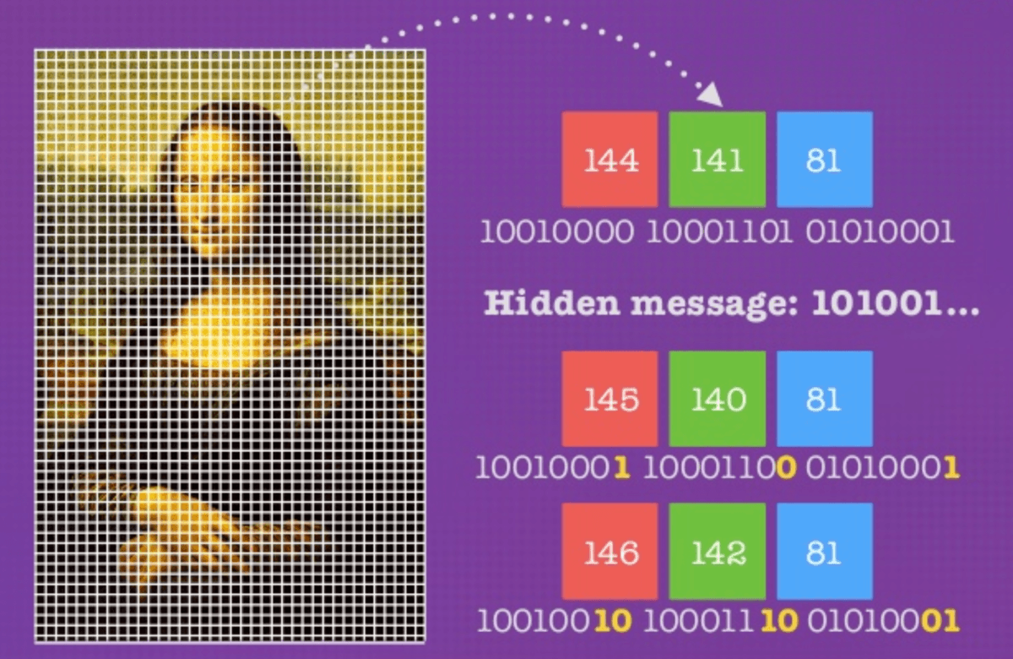
Encryption Types: Steganography

Slide 22
Encryption Types: Cryptography
‘crypt’ means ‘hidden’ and ‘graphy’ means ‘writing’
Cryptography is the technique of securing information and communications through use of codes so that only those person for whom the information is intended can understand it and process it.
Cryptography is the study of hiding critical information by encoding it to a unintelligible form, usually using a secret key
If the information is compromised, the attacker should not be able to decrypt it back to the original information without knowledge of the secret key

Slide 23
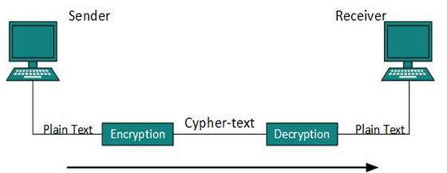
Encryption Types: Cryptography

Slide 24
Types of Cryptography
Symmetric Key
Asymmetric Key
Hash Functions

Slide 25
Types of Cryptography: Symmetric Key
It is an encryption system where the sender and receiver of message use a single common key to encrypt and decrypt messages.
Most secure symmetric key system is implemented by US Government is AES which is practically impossible to break.
Drawback: Sender must share the key with receiver in order to enable them to decrypt.

Slide 26
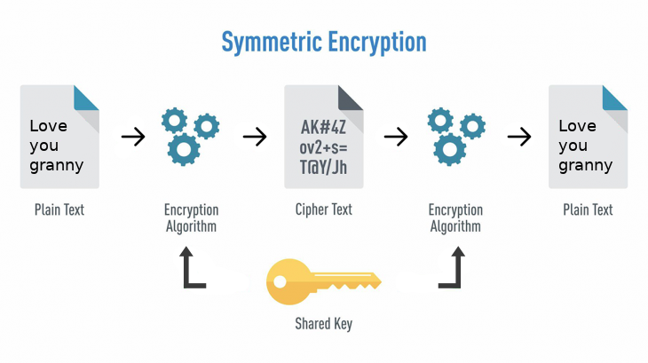
Types of Cryptography: Symmetric Key

Slide 27
Types of Cryptography: Asymmetric Key
Under this system a pair of keys is used to encrypt and decrypt information.
A public key is used for encryption and a private key is used for decryption.
Public key and Private Key are different, so even if the public key is known by everyone the intended receiver can only decode it because they alone knows the private key
Drawback: Longer key size and slower encryption speed

Slide 28
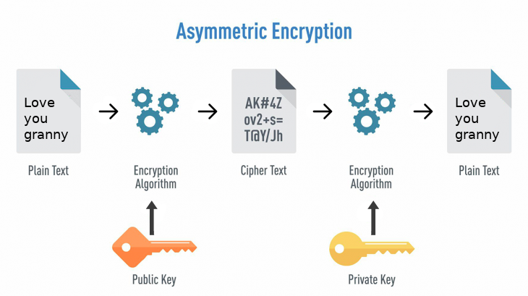
Types of Cryptography: Asymmetric Key

Slide 29
Types of Cryptography: Hash Functions
There is no usage of any key in this algorithm.
A hash value with fixed length is calculated as per the plain text which makes it impossible for contents of plain text to be recovered.
Only way to break hash is brute-force strategy, where you guess what was hashed, then hash it with the same function and see if it matches.
Drawback: Hashing is a one-way function, you can hash the text but you can never unhash it, ever!

Slide 30
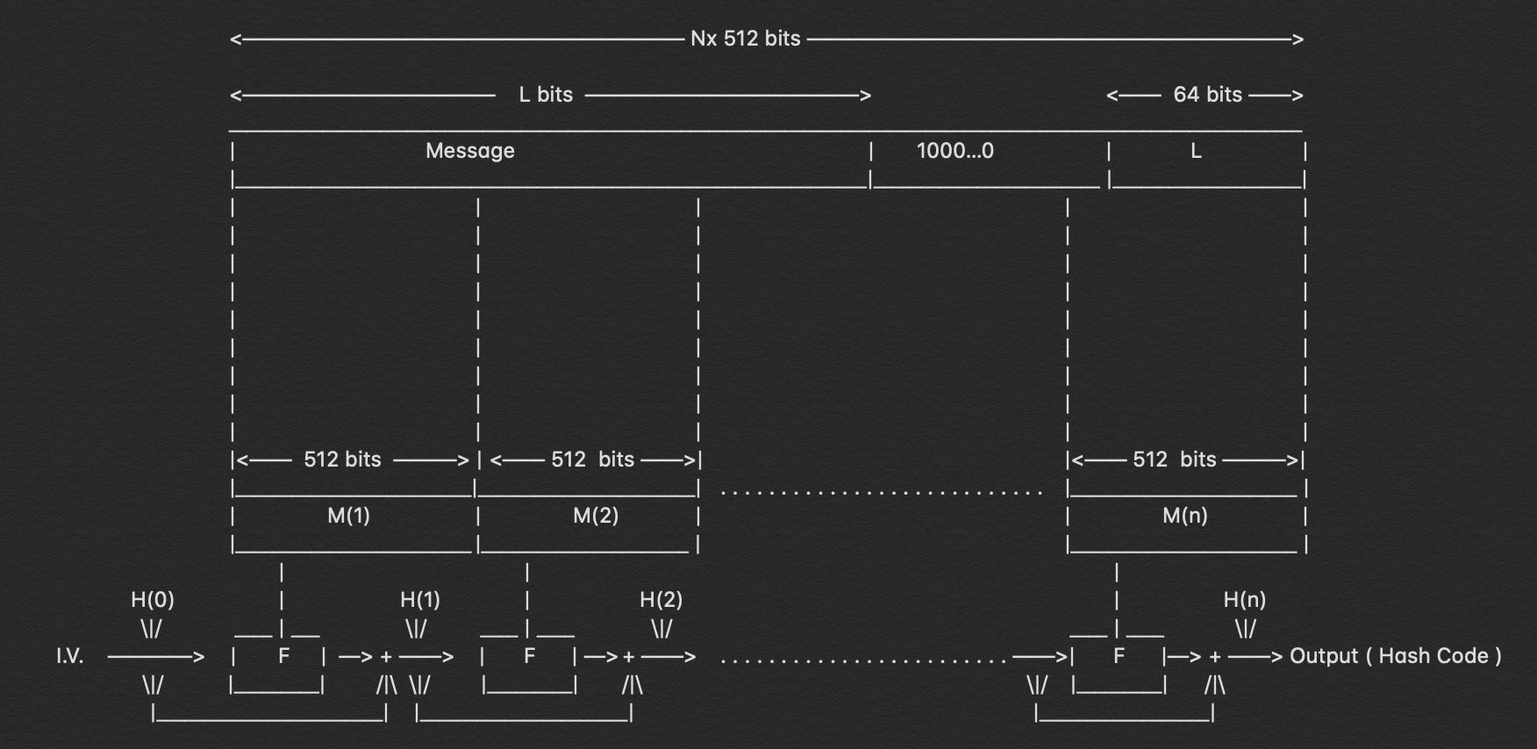
Types of Cryptography: Hash Functions

Slide 31
Characteristics of Hash Function
Deterministic
Quick Computation
Pre-image Resistance
Randomized
Collision Resistant

Slide 32
Characteristics: Deterministic
A hash function needs to have a fixed or specific output
It means is that it doesn’t matter what number of times you process a given input using a hash function; the result is always of the same length.
The hashes can be random and of different patterns, but the same size/length
Imagine getting different results for every transaction you record. It will be impossible for you to keep track of every input data using the hash

Slide 33
Characteristics: Quick Computation
The hash function should be capable of returning the hash of input quickly. If the process isn’t fast enough then the system simply won’t be efficient.
If an ordinary computer needed several minutes to process a cryptographic hash function and receive the output, it would not be very practical.
Nowadays, an average home computer can process an advanced hash function in just a small fraction of a second, hence its not a point of concern.

Slide 34
Characteristics: Pre-image Resistance
Pre-image resistance means that the output of a cryptographic hash function must not reveal any information about the input
If a hash function ‘h’ produced a hash value ‘z’, then it should be a difficult process to find any input value ‘x’ that hashes to ‘z’
If a single word produces small hash and a paragraph produces large hash then it will be a big clue for the hackers to narrow down their brute-force search.
This property protects against an attacker who only has a hash value and is trying to find the input

Slide 35
Characteristics: Randomized
Hash functions should produce different outputs for every input, even if the input data differs by only a digit or letter
Hash of ‘Alpha’ should never be equal to hash of ‘Alpha1’, ‘1Alpha’, ‘Alp1ha’, ‘Al pha’, ‘alpha’ or any other such combination.

Slide 36
Characteristics: Collision Resistant
It must be extremely unlikely to find two different inputs that produce the same output
There are infinite possible inputs that can be entered into a hash function However, outputs are of a fixed length.
This means that there are a finite number of outputs that a hash function can produce.
It is a mathematical certainty that more than one input will produce the same output, however a good hash function should avoid this.

Slide 37
Variations of Hash Functions
Message Digest
RIPEMD
Whirlpool
Secure Hashing Algorithm

Slide 38
Variations: Message Digest
The MD family comprises of hash functions MD2, MD4, MD5 and MD6. It’s a 128-bit hash function that was adopted as Internet Standard
MD5 digests have been widely used in the software world to provide assurance about integrity of transferred file. For example, file servers often provide a pre-computed MD5 checksum for the files.
In 2004, collisions were found in MD5. An analytical attack was reported to be successful only in an hour by using computer cluster. This collision attack resulted in compromised MD5 and hence it is no longer recommended for use.

Slide 39
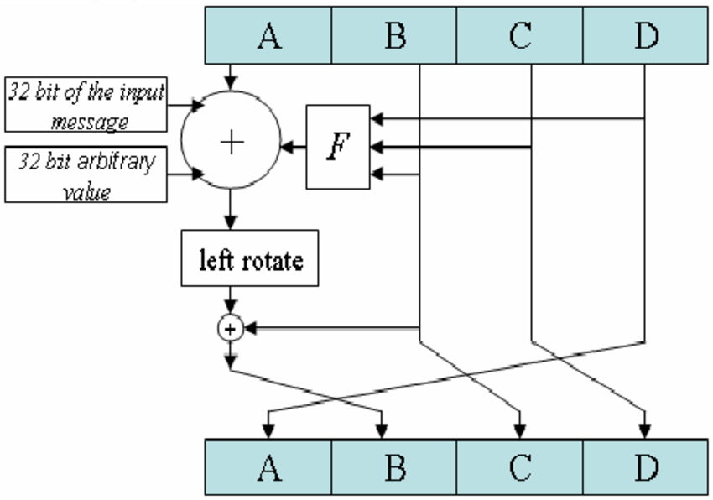

Slide 40
Variations: RIPEMD
Acronym for RACE Integrity Primitives Evaluation Message Digest
This set of hash functions was designed by open research community and generally known as a family of European hash functions
Versions: RIPEMD-128, RIPEMD-160, RIPEMD-256 and RIPEMD-326

Slide 41
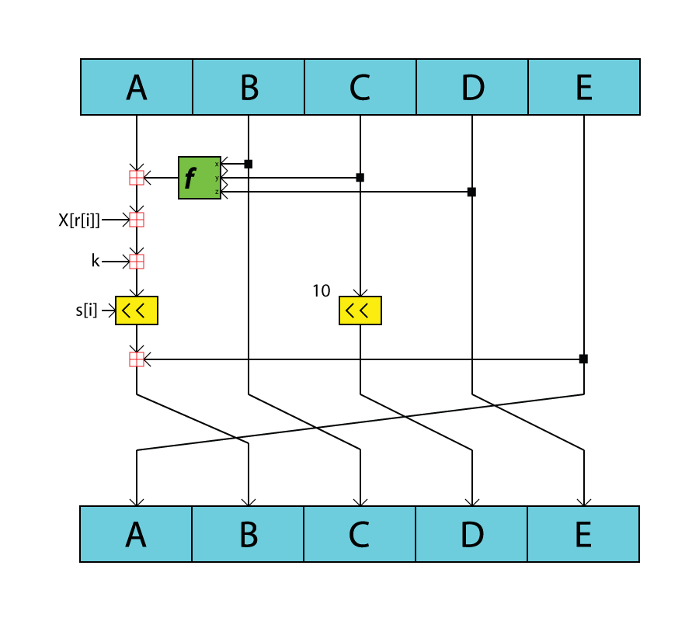

Slide 42
Variations: Whirlpool
A symmetric key based 256-bit hash function based on AES
Whirlpool takes a message of any length less than 2²⁵⁶ bits and returns a 512-bit message digest
Whirlpool is open source algorithm with permission to modify and use it in any from

Slide 43
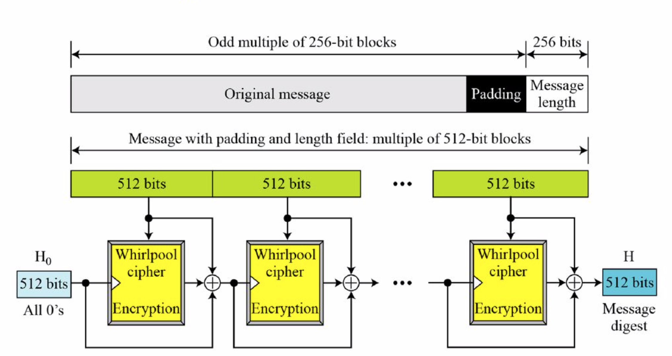

Slide 44
Variations: Secure Hash Algorithm
The original version is SHA-0, a 160-bit hash function, was published by the National Institute of Standards and Technology (NIST) in 1993. It had few weaknesses and did not become very popular.
SHA-1 is the most widely used of the existing SHA hash functions which was made to remove weaknesses of SHA-0. most common use: Secure Socket Layer (SSL) security. However in 2005 collision vulnerability was found in SHA-1.
SHA-2 fixed the collision weakness of SHA-1. SHA-2 family has four further variants, SHA-224, SHA-256, SHA-384, and SHA-512 depending up on number of bits in their hash value. No successful attacks have yet been reported on SHA-2 hash function. most common use: Bitcoin
In October 2012, the NIST chose the Keccak algorithm as the new SHA-3 standard. Keccak offers many benefits, such as efficient performance and good resistance for attacks. most common use: Ethereum

Slide 45
SHA-256 Step 1: Append Padding Bits
First step of hashing function begins with appending bits to our original message, so that its length will be same to the standard length required for the hash function.
To do so, first the original message is converted into hexadecimal
e.g. message = ‘ABC’; hex = ‘414243’
Then few extra bits are added in the hex. The number of bits added are calculated as such so that after addition of these bits the length of the message should be exactly 64 bits less than a multiple of 512
The added bits should begin with ‘1’ and end with ‘0’

Slide 46
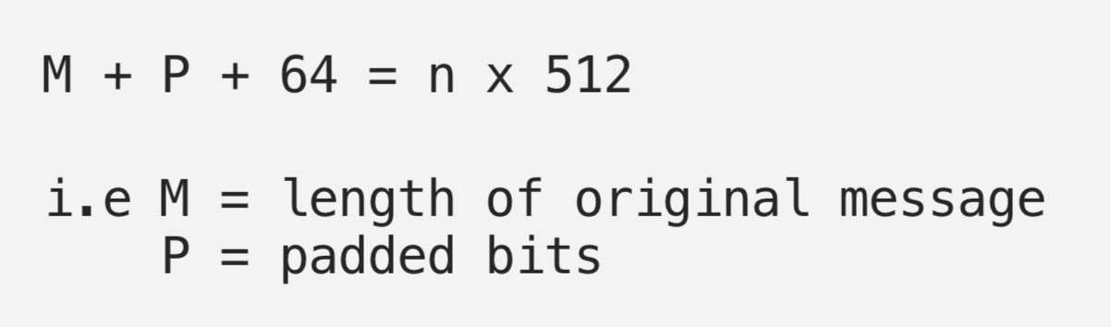
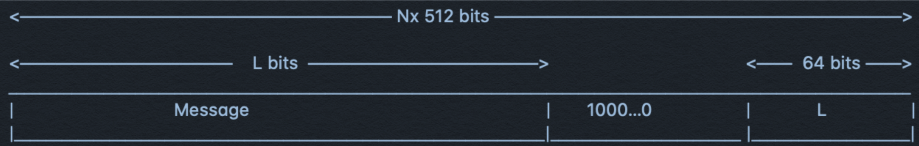

Slide 47
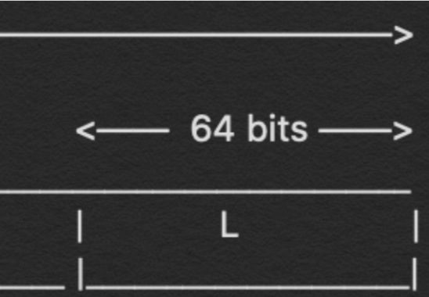
SHA-256 Step 2: Append Length Bits
After appending padding bits to the original message length bits are appended to the message, which is equivalent to 64 bits
Goal is to make the overall message an exact multiple of 512
The way to calculate these 64 bits is by calculating the modulo of the original message, i.e. the one without the padding

Slide 48
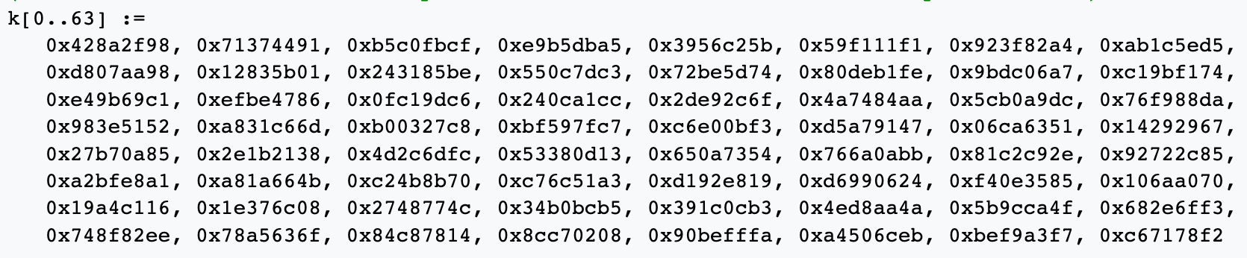
SHA-256 Step 3: Initialize the Buffers
A buffer of 64 unique and constant values are saved in array which will be used in the processing of the main hash function
These buffer values have precise specificity and are used to make the hashes collision resistant
These initial hash values are the 64-bit binary expansion of the fractional part of the square root of the 9th through 16th primes (23, 29, 31, ..., 53)

Slide 49
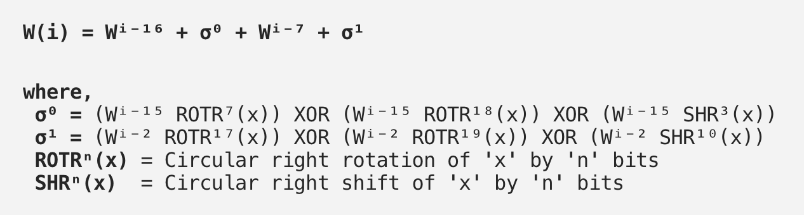
SHA-256 Step 4: Compression Function
The entire message block i.e. ‘n x 512’ bits long is divided into ‘n’ chunks of 512 bits and each of these 512 bits, are then put through 64 rounds of operations
The output from every round acts as an input for the next round and this process keeps on continuing till the last bits of the message remains and the result of the last round for the nᵗʰ part of the message block gives the result i.e. the hash for the entire message

Slide 50
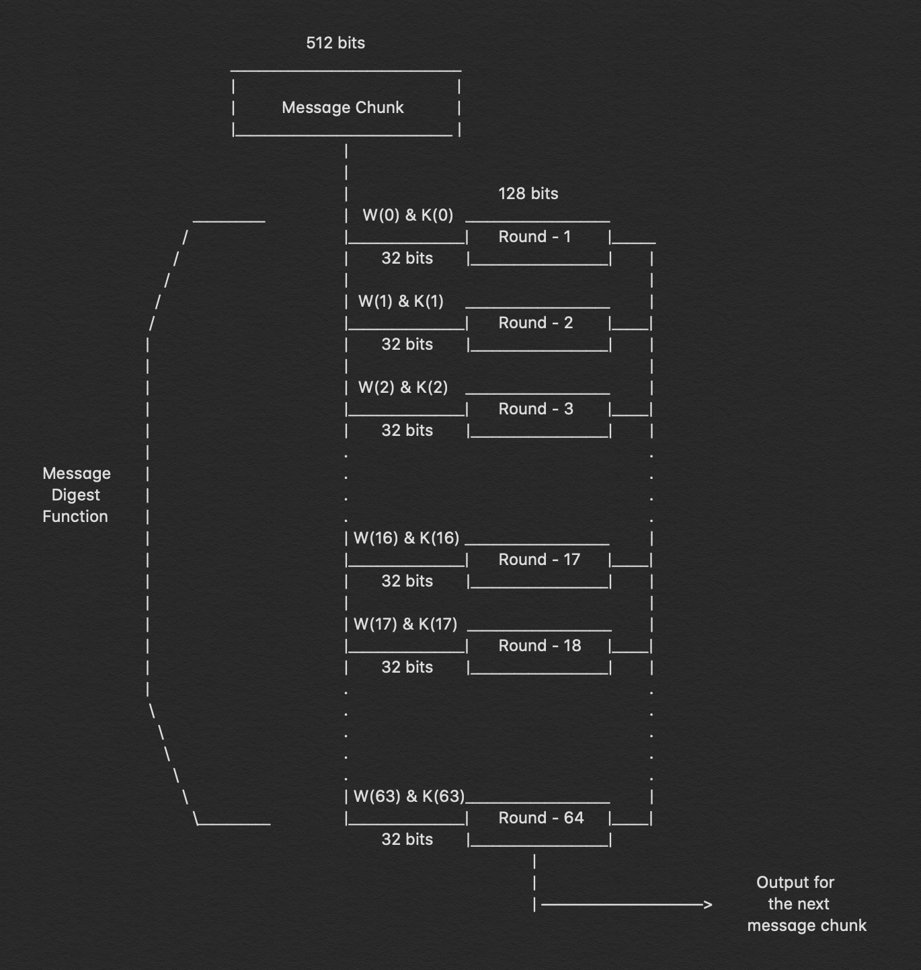

Slide 51
Applications of Hashing
Message Digest
Password Verification
Unique ID Generation
Data Structures
Compiler Operation
Rabin-Karp Algorithm
Linking File name and path
Proof of Work Algorithm

Slide 52
Applications: Message Digest
When files are stored on cloud/server, there is always chance of a third-party accessing and tampering with the files.
Hashes are used to cope with this problem; i.e. a hash of whole file is computed and stored locally.
Upon accessing the file, its hash is generated again and compared with the local version of hash, if both matches then it is certain that the file is not modified.

Slide 53
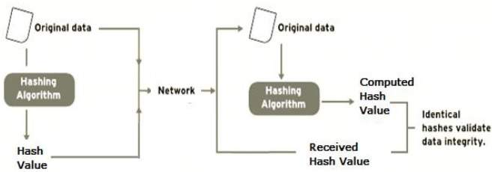
Applications: Message Digest

Slide 54
Applications: Password Verification
Instead of storing password in plain text, mostly all logon processes store the hash values of passwords in the file
The Password file consists of a table of pairs which are in the form (user id, h(P))
An intruder can only see the hashes of passwords. Even if they accessed the password, they can neither logon using hash nor can they derive the password from hash value since hash function possesses the property of pre-image resistance

Slide 55
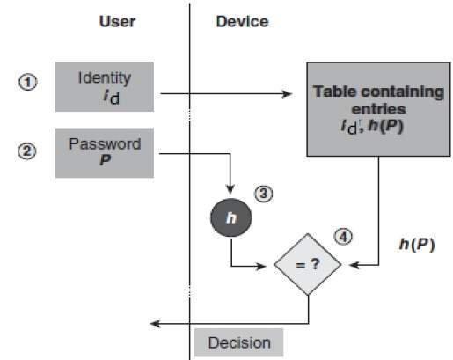
Applications: Password Verification

Slide 56
Applications: Unique ID Generation
Since hashes of different text are always unique so its a common practice to use hash function to generate unique IDs that can be used for identifying objects in a system, e.g. primary key
Usually such hashes are created by combining the timestamp, MAC address and some seed value
Example: 54f7527c589b-11ea8e2d-0242ac130003

Slide 57
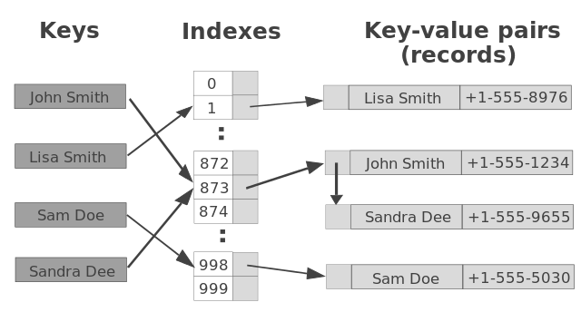
Applications: Data Structure
Various programming languages have hash table based Data Structures.
The basic idea is to create a key-value pair where key is supposed to be a unique value, whereas value can be same for different keys

Slide 58
Applications: Compiler Operation
The keywords of a programming language are processed differently than other identifiers.
To differentiate between the keywords of a programming language (if, else, for, return etc.) and other identifiers and to successfully compile the program, the compiler stores all these keywords in a set which is implemented using a hash table.

Slide 59
Applications: Rabin-Karp Algorithm
One of the most famous applications of hashing is the Rabin-Karp algorithm.
This is basically a string-searching algorithm which uses hashing to find any one set of patterns in a string.
A practical application of this algorithm is detecting plagiarism

Slide 60
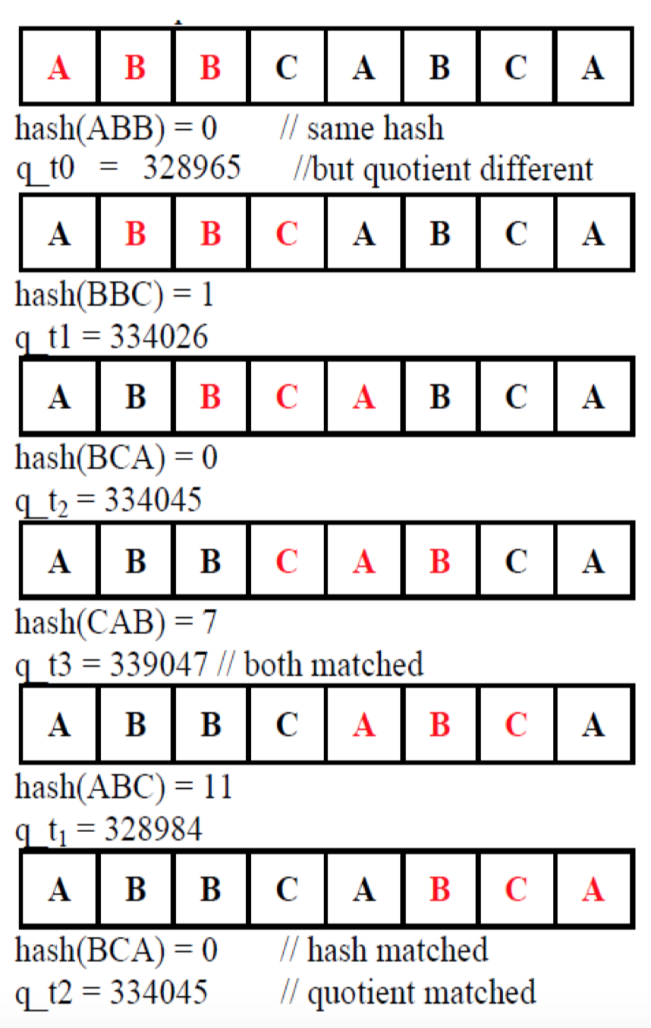

Slide 61
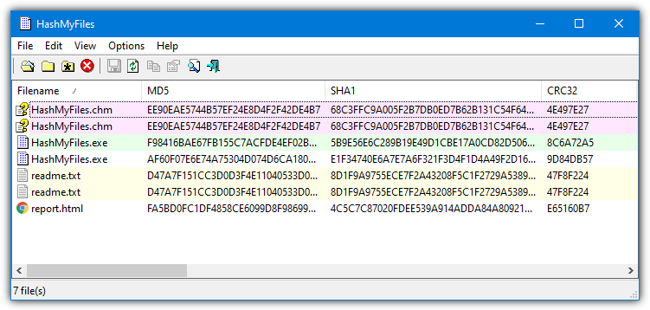
Applications: Linking File name and path
When moving through files on our local system, we observe two very crucial components of a file i.e. file_name and file_path.
In order to store the correspondence between file_name and file_path the system uses a map(file_name, file_path) which is implemented using a hash table

Slide 62
Applications: Proof of Work Algorithm
Most proof-of-work algorithms calculate a hash value which is bigger than certain value (known as mining difficulty)
To find this hash value, miners calculate billions of different hashes and take the biggest of them, because hash numbers are unpredictable.
For example, the proof of work problem might be defined as follows: find a number p, such that hash(x + p)holds 10 zero bits at its beginning.

Slide 63
Reference Book
Bitcoin and Cryptocurrency Technologies
Authors: Arvind Narayanan, Joseph Bonneau, Edward Felten, Andrew Miller, Steven Goldfeder
Publisher: Princeton University Press

